Slide 1

Introduction
These are all new age and technology examples which use concepts of Artificial Intelligence, Machine learning, Deep Learning etc.
The most common programming language used for coding these concepts is Python.

Slide 2
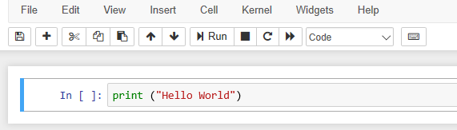
Why Python?
Code readability
Compatibility with different platform.
Interpreter system based code execution
Notes:
Explain each feature of Python

Slide 3
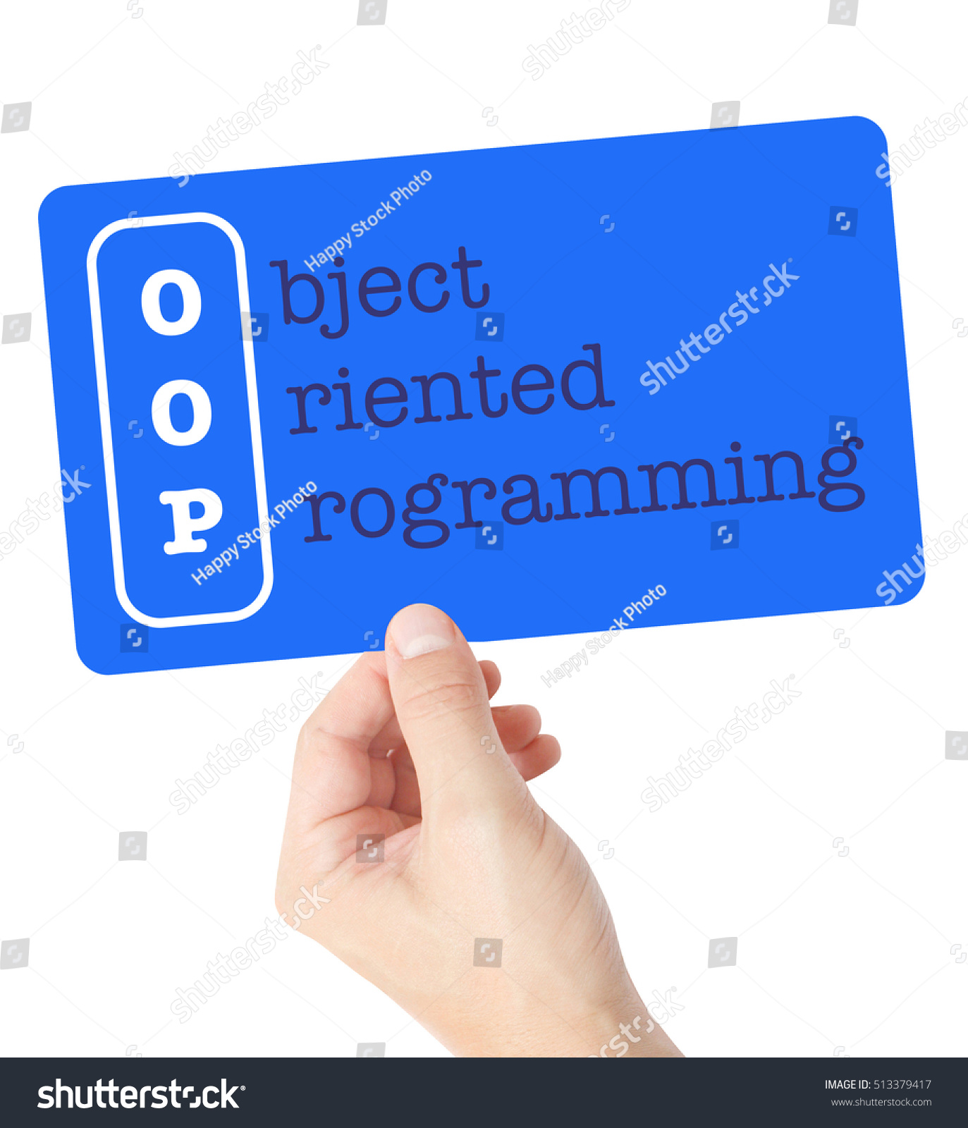
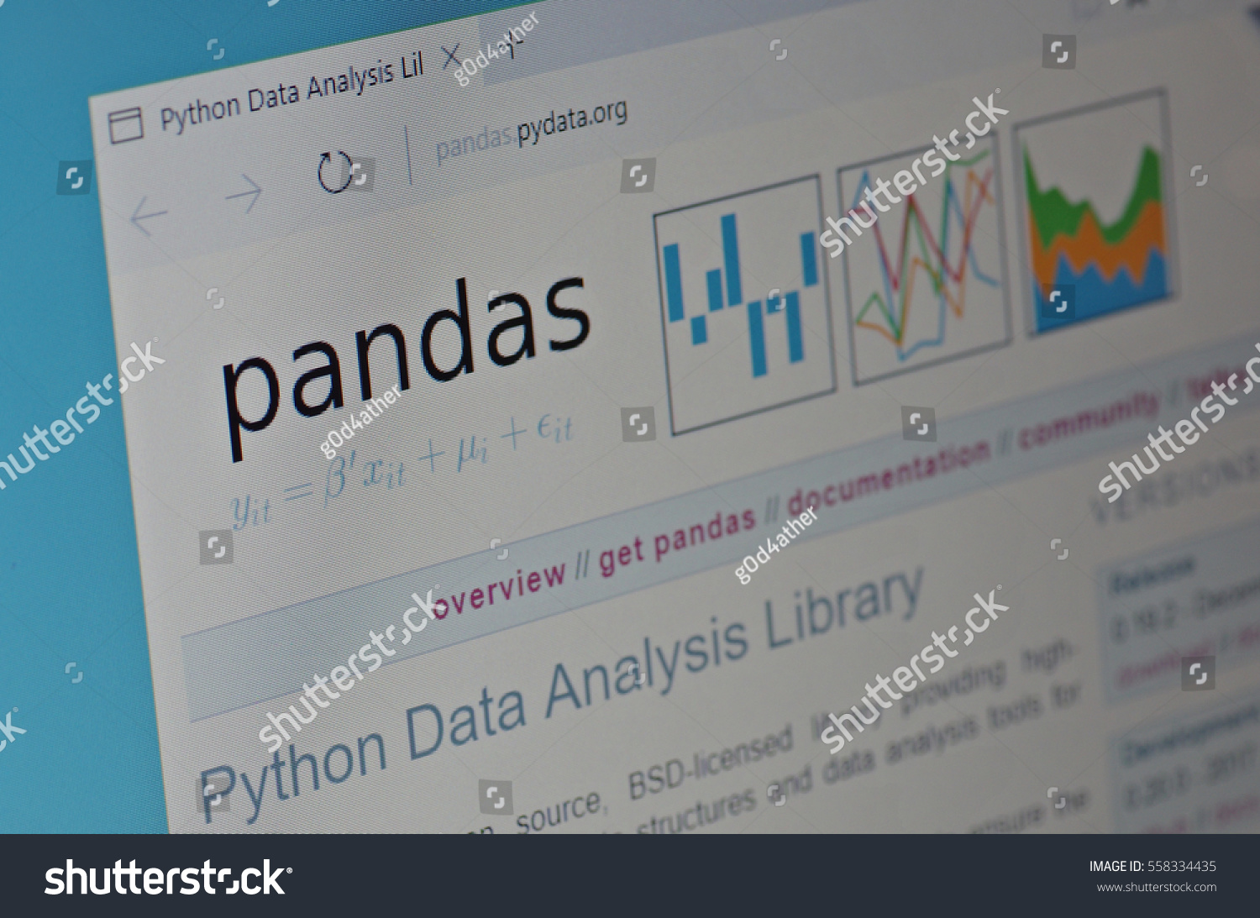
Why Python?
Robust Standard Library
Adaptive development
Object Oriented programming
Notes:
Explain each feature of Python
How adaptive quality of python is useful
Packages present in the library such as NumPy, Pandas, Matplotlib etc and what these packages are used for. Also mentioning some real examples such as visualisations done in the companies, data wrangling etc.
PyPI packages: 230,858

Slide 4
Python
Easy to learn, read and translate in comparison to other languages.
General-purpose and high-level programming language.
Allows you to focus on core functionality of the application by taking care of common programming tasks.
Note: To dig deeper on what is Python, please refer to the below link:
https://www.pythonforbeginners.com/learn-python/what-is-python/

Slide 5
Different IDEs and Code Editors for Python
PyCharm
Jupyter
Spyder
PyDev
Idle
Wing
Eric
Rodeo
Thonny
Additional Resource: To get in-depth knowledge of all the IDEs, please refer the below link.
https://www.softwaretestinghelp.com/python-ide-code-editors/

Slide 6
Why Anaconda?
Anaconda is an open-source distribution that simplifies package management and deployment. Package versions are managed by the package management system 'Conda'.
We strongly recommend using Anaconda to install Python as well as the packages, since it comes preloaded with most of the packages you’ll need.
Advantages of using Anaconda
Easy to manage and get started with most requirements for ML/AI problems
Anaconda comes with many libraries such as NumPy, OpenCV, SciPy, PyQt, the Spyder IDE, etc.

Slide 7
Key Takeaways
The programming language widely used in Data science is Python.
Python is a general-purpose and high-level programming language which allows you to focus on core functionality of the application by taking care of common programming tasks.
Different IDEs and Code Editors for Python
Why we will be using Anaconda.

